Slide 1

30692 Financial Accounting (Module 1 – Session 3)
Academic year 2025-2026
Kasper Regenburg
Assistant Professor of Accounting

Slide 2
Overview
In-class questions
Small recap: Principles of accounting and during the accounting period.
Review of exercises
Beginning year balances
At the end of the accounting period (step 1 – prepare trial balance)
Revenue and expenses
The operation cycle and more on accrual accounting

Slide 3
Small recap:
Basic principles of accounting:
Revenue recognition = When earned / realized
Macthing principle = Expenses should be recognized at same time when revenue that the expenses help generate is recognized
Historical cost = Assets and liabilities recognized at cost the first time.
During the accounting cycle and transactions:
Transactions can be external vs internal, affect two or more accounts (dual effects), and should always satisfy the accounting equation and debit = credit (double-entry bookkeeping).
Analyze transaction (direction, accounts, and number), record journal entries, and post effect on ledger (overview with T-accounts).

Slide 4
Small exercise
Duration:10 min
With?: Alone or in pairs
Objective: Record debit and credit of a transaction in a journal entry and show the transaction effect in T-accounts
Record the journal entries of the transactions below and summarize the transactions in T-accounts.
The owners of Withertop Inc. contribute $100 in cash in return of common stock.
Withertop Inc. purchase a machine to produce their premium ring collection. They pay $25 in cash.
Withertop Inc. also purchase $30 worth of raw materials. Half is paid cash and the rest is on credit.

Slide 5
Small exercise
The owners of Withertop Inc. contribute $100 in cash in return of common stock.
Withertop Inc. purchase a machine to produce their premium ring collection. They pay $25 in cash.
Withertop Inc. also purchase $30 worth of raw materials. Half is paid cash and the rest is on credit.
 |  | Debit | Credit
(1) | Cash (+A) | 100
 | Common stock (+SE) |  | 100

Slide 6
Small exercise
The owners of Withertop Inc. contribute $100 in cash in return of common stock.
Withertop Inc. purchase a machine to produce their premium ring collection. They pay $25 in cash.
Withertop Inc. also purchase $30 worth of raw materials. Half is paid cash and the rest is on credit.
 |  | Debit | Credit
(2) | PPE (+A) | 25
 | Cash (-A) |  | 25

Slide 7
Small exercise
The owners of Withertop Inc. contribute $100 in cash in return of common stock.
Withertop Inc. purchase a machine to produce their premium ring collection. They pay $25 in cash.
Withertop Inc. also purchase $30 worth of raw materials. Half is paid cash and the rest is on credit.
 |  | Debit | Credit
(3) | Inventory (+A) | 30
 | Cash (-A) |  | 15
 | Accounts payable (+L) |  | 15

Slide 8
Small exercise
 |  | Debit | Credit
(1) | Cash (+A) | 100
 | Common stock (+SE) |  | 100
(2) | PPE (+A) | 25
 | Cash (-A) |  | 25
(3) | Inventory (+A) | 30
 | Cash (-A) |  | 15
 | Accounts payable (+L) |  | 15
 |  | 155 | 155

Slide 9
Small exercise
Asset accounts |  |  |  |  |  | Equity and liab. accounts
Cash |  |  |  |  |  | Common stock
Debit |  |  | Credit |  |  | Debit |  |  | Credit
100 | (1) | 25 | (2) |  |  |  |  | 100 | (1)
 |  | 15 | (3)
60
PPE |  |  |  |  |  | Accounts payable
Debit |  |  | Credit |  |  | Debit |  |  | Credit
25 | (2) |  |  |  |  |  |  | 15 | (3)
25
Inventory
Debit |  |  | Credit
30 | (3)
30
Debit: 60 + 25 + 30 = 115 Credit: 100 + 15 = 115
Notes:
T-account template is available on Blackboard, but you can also do it in hand.

Slide 10
Review of exercises for chapter 1
We will not go through exercises 1 and 2 → The answers will be posted on the
Blackboard course page → Materials → Review session solution.

Slide 11
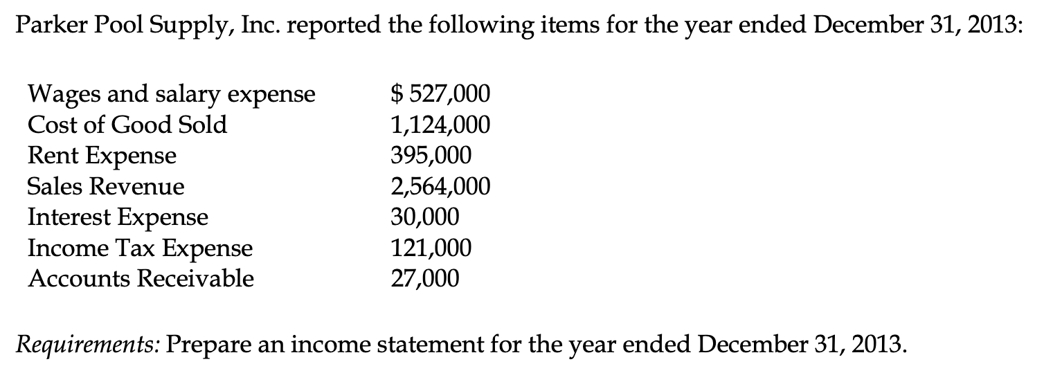
Review of exercise 3 for chapter 1

Slide 12
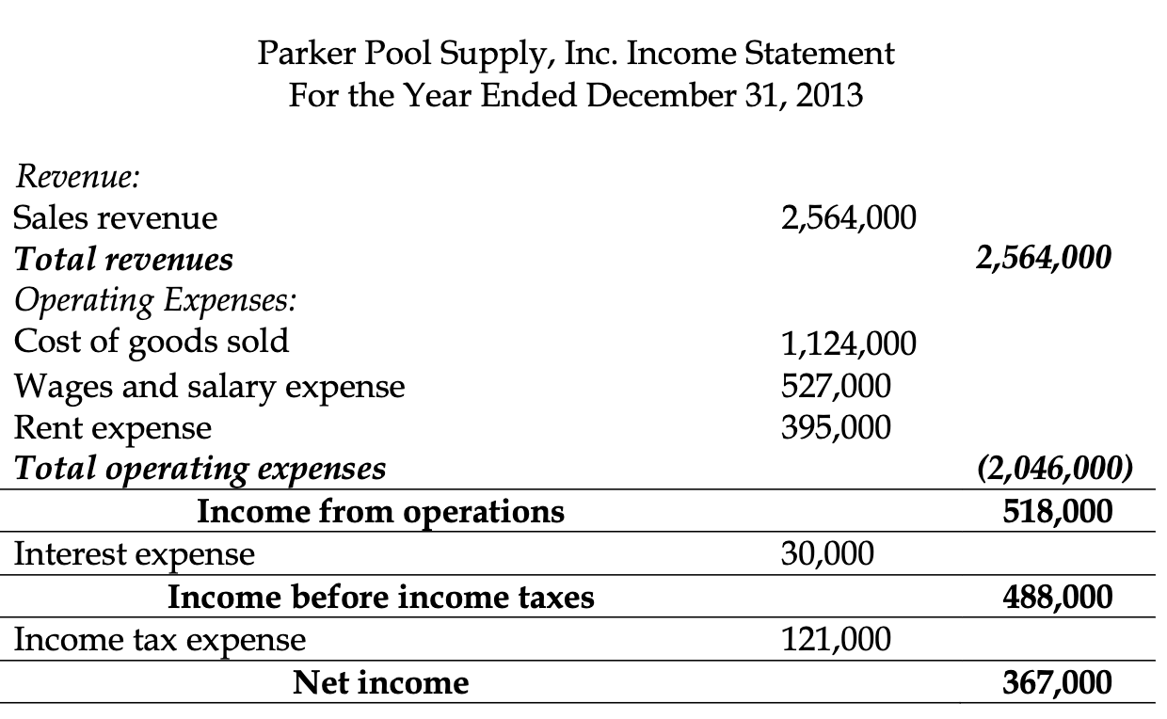
Review of exercise 3 for chapter 1

Slide 13
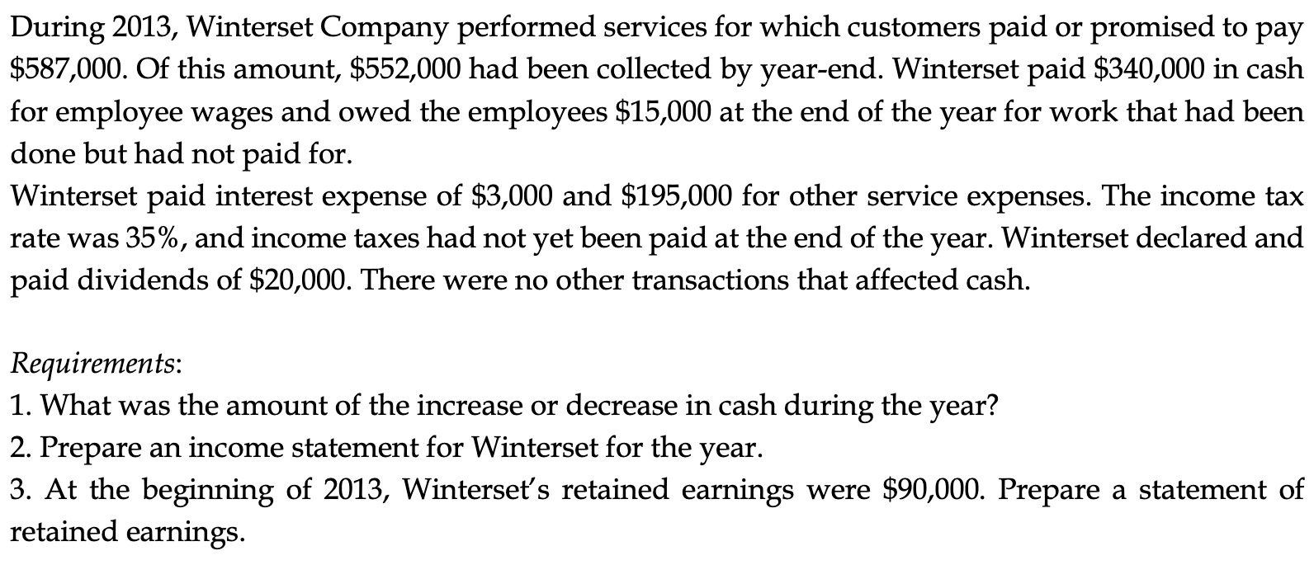
Review exercise 4 for chapter 1
Notes:
Answers on whiteboard and on Blackboard after class.

Slide 14
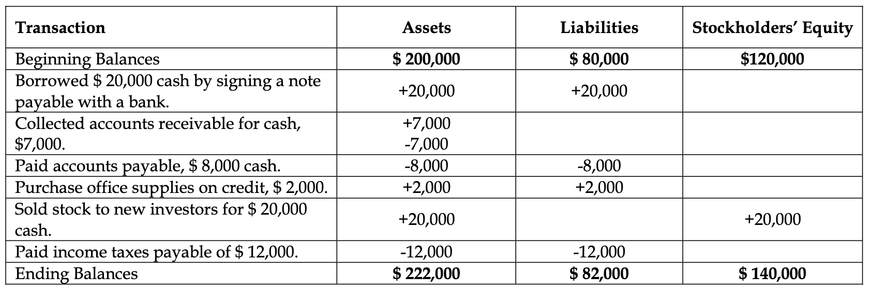
Review exercise 1 for chapter 2

Slide 15
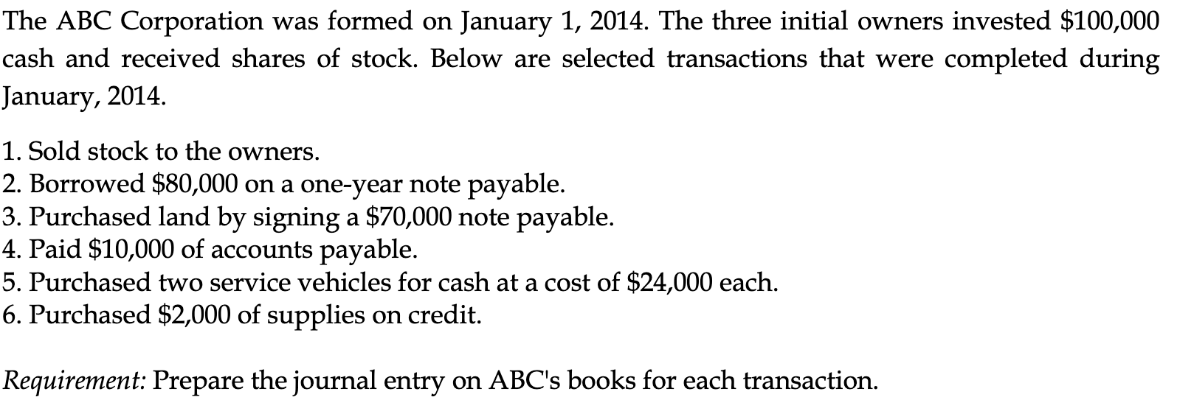
Review of exercise 2 for chapter 2
Notes:
Answers on whiteboard and on Blackboard after class.

Slide 16
Overview
In-class questions
Small recap: Principles of accounting and during the accounting period.
Review of exercises
Beginning year balances
At the end of the accounting period (step 1 – prepare trial balance)
Revenue and expenses
The operation cycle and more on accrual accounting

Slide 17
Beginning of year balances
Asset accounts |  |  |  |  |  | Equity and liab. accounts
Cash |  |  |  |  |  | Common stock
Debit |  |  | Credit |  |  | Debit |  |  | Credit
925 | (1/1-25) |  |  |  |  |  |  | 800 | (1/1-25)
Inventory |  |  |  |  |  | Accounts payable
Debit |  |  | Credit |  |  | Debit |  |  | Credit
225 | (1/1-25) |  |  |  |  |  |  | 500 | (1/1-25)
Property, plant, and equipment |  |  |  |  |  | Salaries payable
Debit |  |  | Credit |  |  | Debit |  |  | Credit
450 | (1/1-25) |  |  |  |  |  |  | 300 | (1/1-25)

Slide 18
Beginning of year balances
Asset accounts |  |  |  |  |  | Equity and liab. accounts
Cash |  |  |  |  |  | Common stock
Debit |  |  | Credit |  |  | Debit |  |  | Credit
925 | (1/1-25) | 200 | (1) |  |  |  |  | 800 | (1/1-25)
200 | (4) | 150 | (2)
 |  | 160 | (3)
Inventory |  |  |  |  |  | Accounts payable
Debit |  |  | Credit |  |  | Debit |  |  | Credit
225 | (1/1-25) |  |  |  |  | 200 | (1) | 500 | (1/1-25)
150 | (2)
Property, plant, and equipment |  |  |  |  |  | Salaries payable
Debit |  |  | Credit |  |  | Debit |  |  | Credit
450 | (1/1-25) | 200 | (4) |  |  | 160 | (3) | 300 | (1/1-25)

Slide 19
Beginning of year balances
Debit: 615 + 375 + 250 = 1240
Credit: 800 + 300 + 140 = 1240
Asset accounts |  |  |  |  |  | Equity and liab. accounts
Cash |  |  |  |  |  | Common stock
Debit |  |  | Credit |  |  | Debit |  |  | Credit
925 | (1/1-25) | 200 | (1) |  |  |  |  | 800 | (1/1-25)
200 | (4) | 150 | (2)
 |  | 160 | (3)
615 |  |  |  |  |  |  |  | 800
Inventory |  |  |  |  |  | Accounts payable
Debit |  |  | Credit |  |  | Debit |  |  | Credit
225 | (1/1-25) |  |  |  |  | 200 | (1) | 500 | (1/1-25)
150 | (2)
375 |  |  |  |  |  |  |  | 300
Property, plant, and equipment |  |  |  |  |  | Salaries payable
Debit |  |  | Credit |  |  | Debit |  |  | Credit
450 | (1/1-25) | 200 | (4) |  |  | 160 | (3) | 300 | (1/1-25)
250 |  |  |  |  |  |  |  | 140

Slide 20
Trial balance
Debit: 615 + 375 + 250 = 1240
Credit: 800 + 300 + 140 = 1240
Company A – Trial Balance Dec 31, 2025 (in millions of euros) | Debit | Credit
Cash | 615
Inventory | 375
Property, plant, and equipment | 250
Salaries payable |  | 140
Accounts payable |  | 300
Common stock |  | 800
Total | 1240 | 1240

Slide 21
Overview
In-class questions
Small recap: Principles of accounting and during the accounting period.
Review of exercises
Beginning year balances
At the end of the accounting period (step 1 – prepare trial balance)
Revenue and expenses
The operation cycle and more on accrual accounting

Slide 22
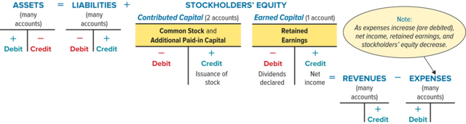
Expanding the debit and credit accounts

Slide 23
Expanding the debit and credit accounts

Slide 24
Revenue
Definition:
Inflows or other enhancements of assets of an entity or settlements of its liabilities (or a combination of both) from delivering or producing goods, rendering services, or other activities that constitute the entity's ongoing major or central operations.
Order in the income statement: Core revenue(s) at the top, other revenue in ”other income”.
Notes:
Linked to assets and liabilities, so it thus also have to be measurable.

Slide 25
Expenses
Definition:
Outflows or other using up of assets or incurrences of liabilities (or a combination of both) from delivering or producing goods, rendering services, or carrying out other activities that constitute the entity’s ongoing major or central operations.
Order in the income statement: Operating section: Typically ordered how closely the expense varies with the revenue. Other section, sometimes with financial items grouped, and taxes.

Slide 26
Expenses
Examples
Cost of goods sold/cost of sales,
Salary expense,
Rent expense,
Other operating expenses,
Income tax expense,
Depreciation expense, and
Interest expenses.
Notes:
Read page 113-114 of the book for a list of Chipotle’s expenses

Slide 27
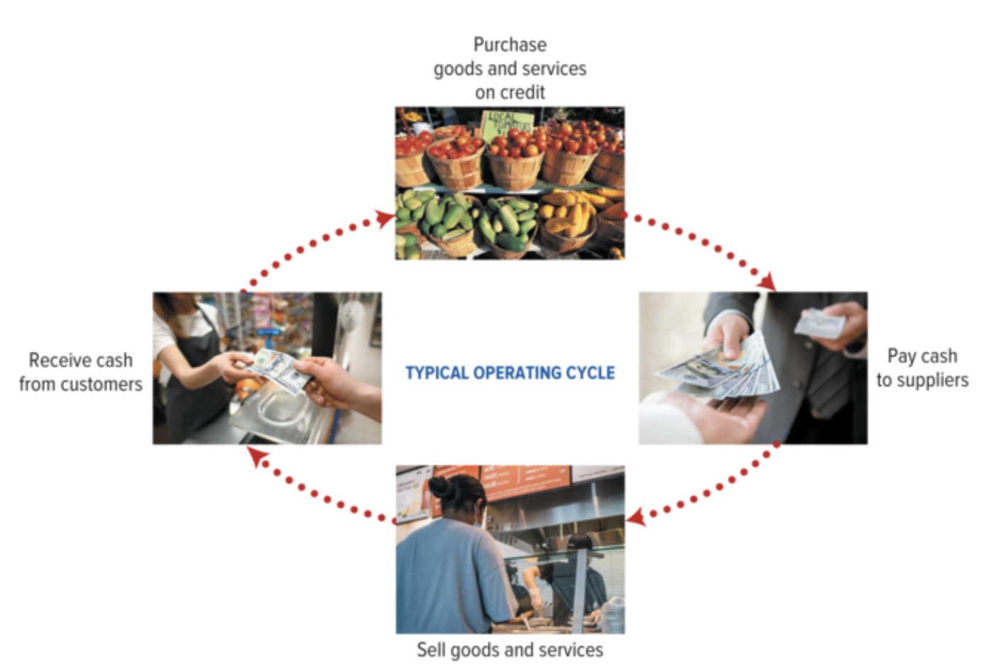
The operating cycle

Slide 28
The operating cycle: Accrual accounting
Last year 2023
This year 2024
Next year 2025
10
10
20
20
Revenue = 20
Expenses = 10
Income statement
Net income = 20 - 10 = 10
Cash = -10 + 20 = 10
= Receives goods from supplier
= Payment to supplier
= Sells product to customer
= Receives cash from customer
Notes:
Notice that with these expenses, we strictly assume that they are the only one. We will expand this later.

Slide 29
The operating cycle: Accrual accounting
Last year 2023
This year 2024
Next year 2025
10
10
20
20
10
10
20
20
Revenue = 2 x 20= 40
Expenses = 2 x 10 = 20
Net income = 40 - 20 = 20
Cash = -10 + 20 – 10 = 0
= Receives goods from supplier
= Payment to supplier
= Sells product to customer
= Receives cash from customer

Slide 30
The operating cycle: Accrual accounting
Last year 2023
This year 2024
Next year 2025
10
10
20
20
10
10
20
20
10
10
20
20
Revenue = 2 x 20 = 40
Expenses = 2 x 10 = 20
Revenue = 20
Net income = 40 - 20 = 20
Expenses = 10
Cash = -10 + 20 – 10 = 0
Net income = 10
Inventory = 10
Accounts payable = 10
Cash = 20 + 20 – 10 = 30
= Receives goods from supplier
= Payment to supplier
= Sells product to customer
= Receives cash from customer

Slide 31
The operating cycle: Accrual accounting
Last year 2023
This year 2024
Next year 2025
Revenue = 3 x 20 = 60
10
10
20
20
Expenses = 3 x 10 = 30
Net income = 60 – 30 = 30
10
10
20
20
Cash = 4 x 20 – 3 x 10 = 50
10
10
20
20
Revenue = 2 x 20 = 40
10
10
20
20
Expenses = 2 x 10 = 20
Net income = 40 - 20 = 20
10
10
20
20
Cash = -10 + 20 – 10 = 0
Inventory = 10
Accounts payable = 10
10
10
20
20
= Receives goods from supplier
= Payment to supplier
= Sells product to customer
= Receives cash from customer

Slide 32
The operating cycle: Accrual accounting
Last year 2023
This year 2024
Next year 2025
20
10
20
10
Deferred revenue (L) = 20
Accounts payable (L) = 10
Accounts payable (L) = 0
Cash (A) = 20
Revenue = 20
Cash (A) = 10
Expenses = 10
Net income (SE)= 20 - 10 = 10
Deferred revenue (L) = 0
Cash (A) = 20
= Receives goods from supplier
= Payment to supplier
= Sells product to customer
= Receives cash from customer
Notes:
Example of deferred revenue.

Slide 33
Accrual accounting
 | Asset account | Liability account
Cash flow before revenue or expense incurs | Deferred expense Cash outflow in period t Expense in period t+1 Examples: Prepaid rent or insurance Property, plant, and equipment (which we depreciate) | 2) Deferred revenue Cash inflow in period t Revenue in period t+1 Examples Prepaid revenue (when a customers pays before in advance). Gift cards Rental collected in advance
Cash flow after revenue or expense incurs | 3) Accrued asset Revenue in period t Cash inflow in period t+1 Examples: Accounts receivable Other receivables | 4) Accrued liability Expense in period t Cash outflow in period t+1 Examples: Payroll, utilities, taxes (certain payments)
t = current year, t+1 = next year

Slide 34
Small exercise
Duration: 5 min
With?: Alone or in pairs
Objective: Determine the revenue, expense, income, and cash effect of operation transactions.
Bananas Consulting Group (BCG) receive a prepayment of $14,520 for services that they expect to provide early next year.
BCG provide consulting services worth $17,400 for the client McHansy. McHansy pay half now and defer the rest of the pay to the next month.
The sum of wages to the BCG consultants for the McHansy delivery is $8.900.
Record the journal entries for BCG and show the T-accounts.

Slide 35
For next time
Read chapter 3

